Slide 1
CREDIT RISK ANALYSIS
Arunthavaselvi S
PGA 40
Hyderabad
Dashboard using Power BI

Slide 2
CREDIT RISK ANALYSIS
.
The possibility of a borrower failing to meet financial obligations
IMPORTANCE OF CREDIT RISK
Crucial for financial institutions in minimizing loan defaults.
Impacts profitability, capital allocation, and regulatory compliance.

Slide 3
PROBLEM STATEMENT:
BACKGROUND:
Financial institutions face challenges in assessing credit risk due to complex and fragmented data. The lack of a unified, real-time view of credit risks limits the ability to make timely, informed lending decisions.
OBJECTIVE:
To create an intuitive Power BI dashboard that consolidates data from various sources to analyze and assess the credit risk profile.
SCOPE:
The dashboard will focus on key credit risk indicators such as credit scores, payment histories, outstanding debt, and economic factors across customer segments.

Slide 4
DEBT TO INCOME
The Debt-to-Income (DTI) ratio is a critical financial metric used to evaluate an individual's ability to manage monthly debt payments relative to their gross income.
It plays a significant role in credit risk analysis, particularly for lenders assessing a borrower's financial health before extending credit or a loan.

Slide 5
DTI Ratio= (Total Monthly Debt Payments / Gross Monthly Income ​)×100
Low DTI (<36%)
Moderate DTI (36%–49%)
High DTI (≥50%)

Slide 6
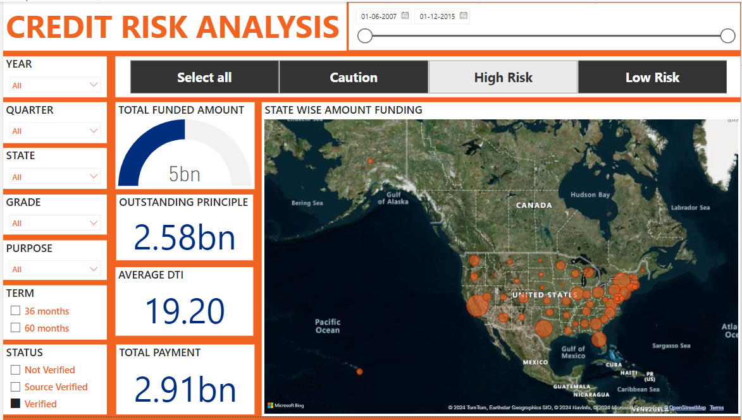

Slide 7
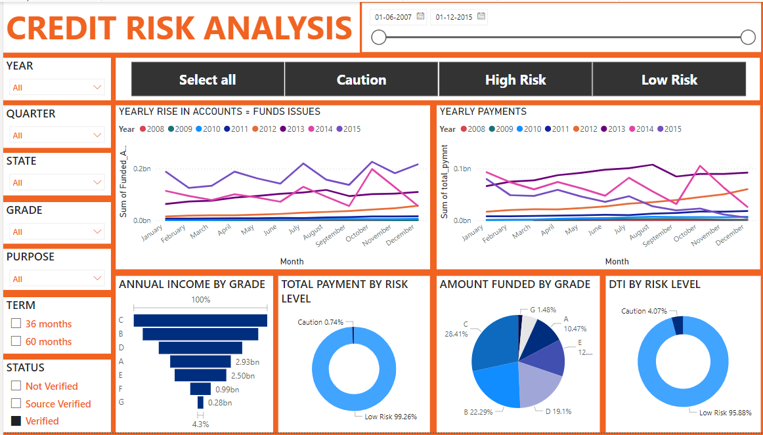

Slide 8
SUGGESTIONS
Implement proactive monitoring systems to identify early warning signs of potential default.
Diversify risk exposure across regions, grades, and purposes to avoid concentration risk.
Enhance verification processes to ensure accurate and reliable borrower information.

Slide 9
FUTURE SCOPE
Incorporate machine learning models to predict defaults.
Add real-time data integration for live monitoring.
Expand the dashboard to include more financial metrics
Use for strategic planning and regulatory reporting.

Slide 10
Conclusion
Effective credit risk analysis is crucial for financial institutions to mitigate default rates and ensure financial stability.
Through a comprehensive examination of high default rates, inadequate verification processes, and concentration of credit risk, we have gained valuable insights into key areas of concern.
By leveraging data analytics and implementing our recommended solutions, banks can enhance risk management practices and make informed decisions.
It is imperative for professionals in the banking industry, risk analysts, and data analysts to collaborate and drive positive changes in credit risk management

